Slide 1

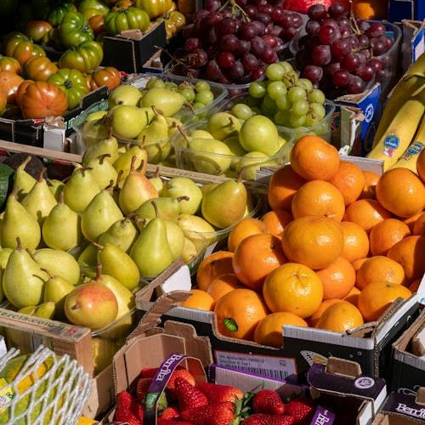
COUNTING HEALTHY SNACKS
Shopping for Fruits and Treats!

Slide 2

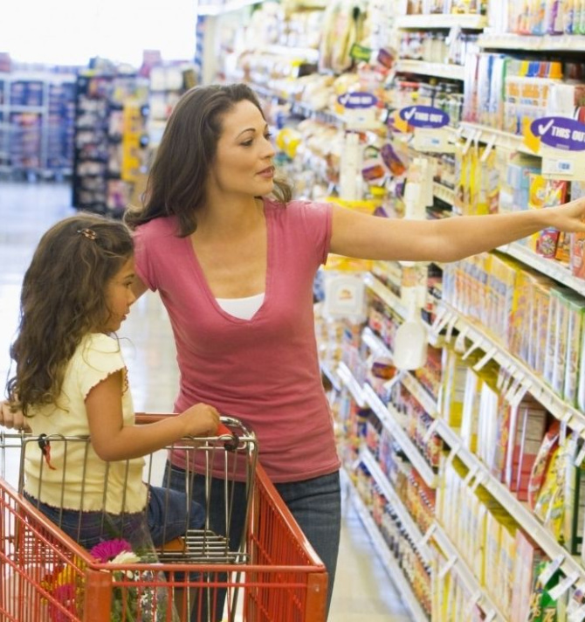
TODAY'S GOALS
By the end of this lesson, you will be able to:
Use some and any correctly with countable fruits.
Describe amounts using many and a few.
Talk about your grocery list like a pro!

Slide 3
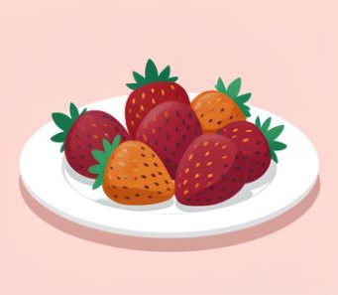
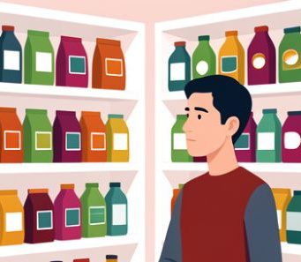
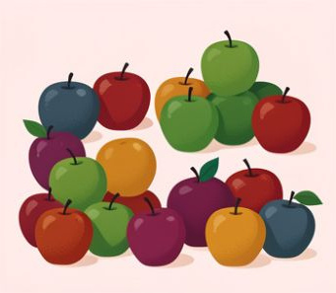
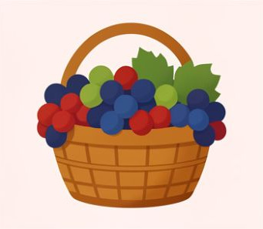
SHOPPING WORDS TO KNOW
Countable
Things we can count one by one, like strawberries.
Question
A sentence used to find out information.
Quantity
How much or how many of something we have.
Amount
The total size or number of something.

Slide 4
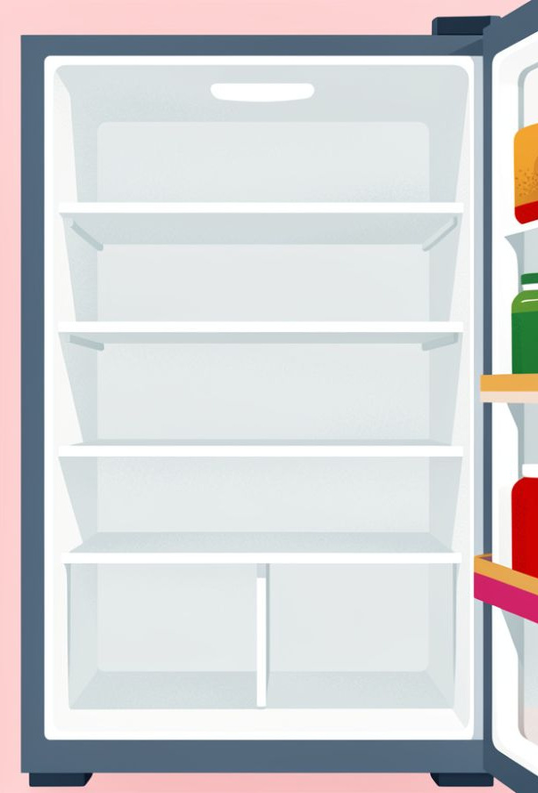
THE EMPTY FRIDGE MYSTERY
Imagine you open your fridge at home in Turkey and find... nothing! No fruit, no milk, no snacks.
What is the first thing you would ask for? Today, Tom is going shopping because Emma's fridge is totally empty!
🔍
Example
Tom: 'Do we need anything special?'
Emma: 'Yes! We have no fruit at home.'

Slide 5
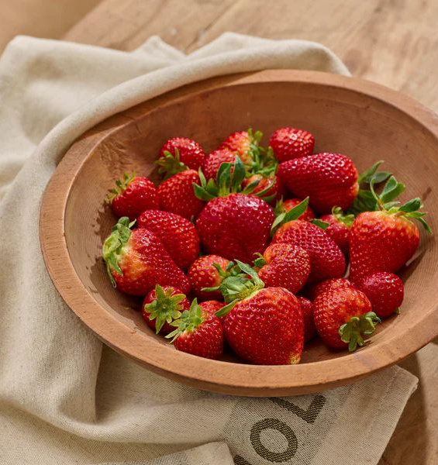
USING 'SOME' AND 'ANY'
When we talk about countable things like strawberries or grapes, we follow a simple rule:
Use some for positive sentences (I have...).
Use any for questions or negative sentences (Do we have...? / I don't have...).
🔑
Key point
Emma says: 'Please buy some strawberries.' because it's a positive request!

Slide 6
QUICK CHECK!
Answers on the next slide...
Emma says: 'We don't have ____ grapes.' Which word fits best?
1.
Some
2.
Any
3.
A few
4.
Many

Slide 7
QUICK CHECK!
✅​
Emma says: 'We don't have ____ grapes.' Which word fits best?
1.
Some
2.
Any
👍​
3.
A few
4.
Many

Slide 8
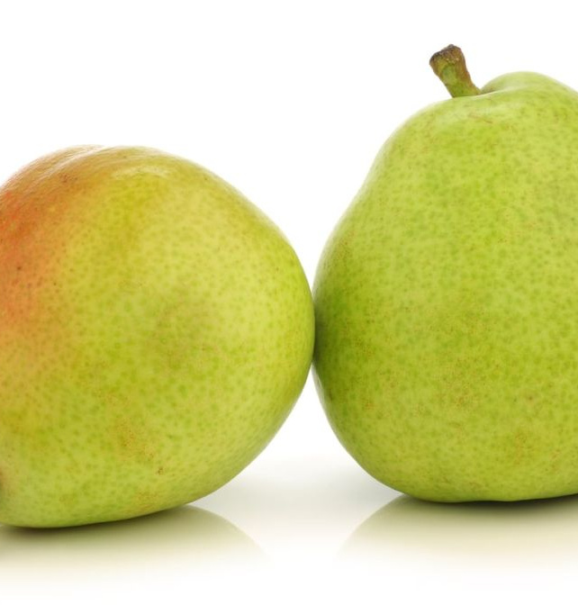
MANY VS. A FEW
Sometimes we want to be more specific about the amount.
Many is for a large number.
A few is for a small number.
Just a few. We don't eat many pears. — Emma

Slide 9
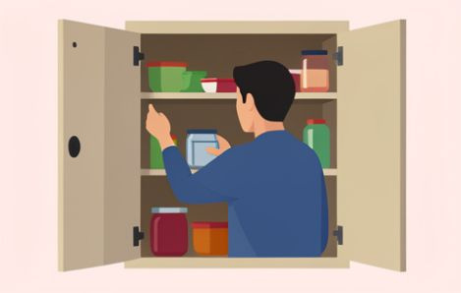
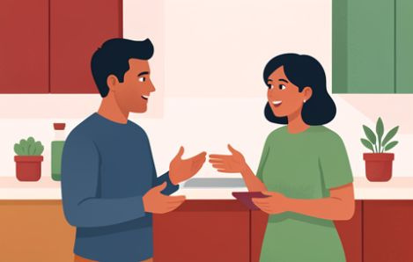

SHOPPING STEPS
Check the Kitchen
See what you are missing. 'We don't have any fruit.'
Ask Questions
'How many pears do we need?'
Make a List
'I will buy some strawberries and a few pears.'

Slide 10

FINISH THE GROCERY LIST
We need to buy ____ grapes, but we don't need ____ pears because we still have ____ in the bowl.
Word bank 🏦​
a few, any, some, nothing, some, many
Answers on the next slide...

Slide 11
FINISH THE GROCERY LIST
✅​
We need to buy some grapes, but we don't need any pears because we still have a few in the bowl.
Word bank 🏦​
a few, any, some, nothing, some, many

Slide 12

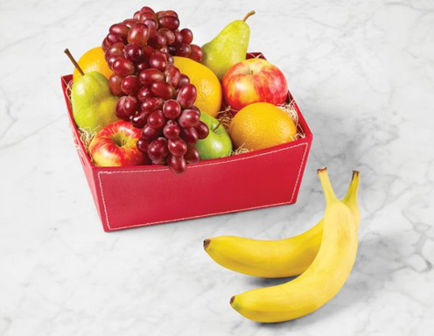
WHAT'S IN YOUR BASKET?
Imagine you are at the market. You want to make a fruit salad for your classmates. Which fruits will you buy 'some' of, and which ones do you only need 'a few' of?

Slide 13
WHAT'S IN YOUR BASKET?
✅​
You might have said...
I would buy some grapes because they are small and everyone likes them.
I only need a few watermelons because they are very large!
I would check if we have any apples before buying more.

