Slide 1


Family Structures and Living Spaces
Exploring how we live and who we share our homes with.

Slide 2


Our Learning Journey
Today, we are going to explore different types of families and the beautiful homes they live in. By the end of this lesson, you will be able to:
Distinguish between nuclear and extended families.
Identify different rooms and family roles in a home.
Compare apartment flats and detached houses.

Slide 3
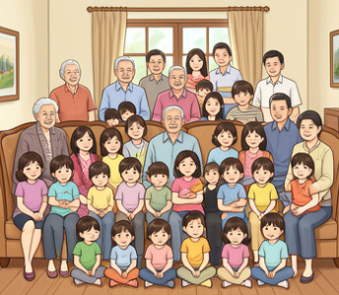
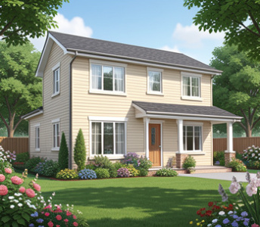

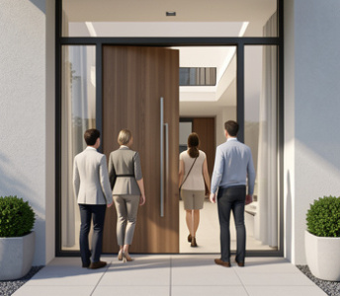
Key Vocabulary
Extended Family - Includes grandparents, aunts, and uncles.
Detached House - A house not joined to others.
Nuclear Family - Parents and children living together.
Household - People living together in one home.

Slide 4
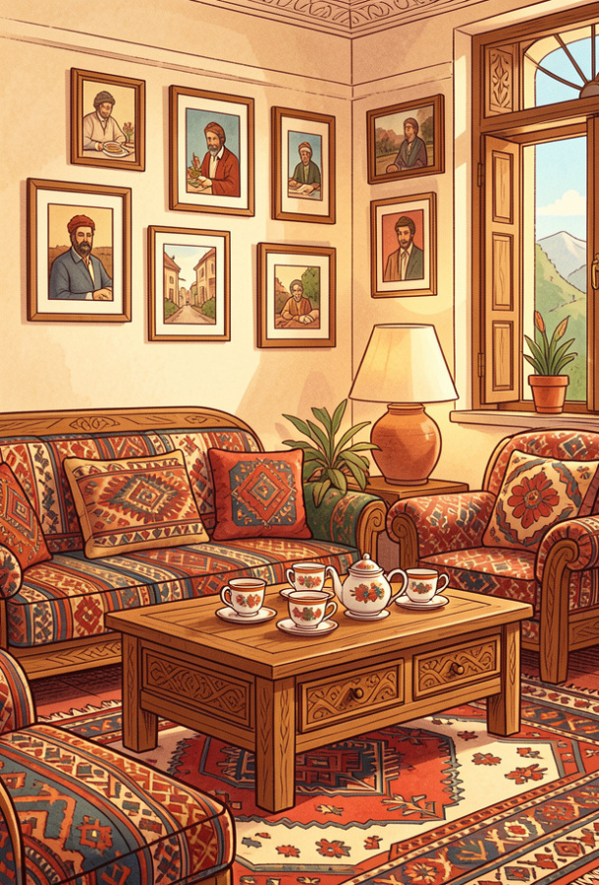
Who makes a house a home?
Think about your home...
Is it busy with relatives or quiet with just parents?
Turkish families come in many sizes! Whether you live with grandparents or siblings, every family is special.

Slide 5
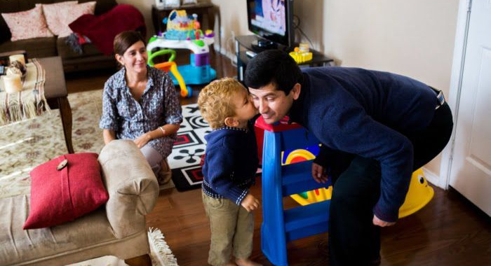
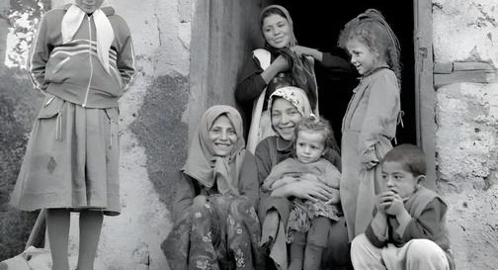
Family Photo Collage
Look at these Turkish households. Can you spot the differences?
Nuclear Families
These are small groups of parents and kids living together.
Extended Families
These large households often include three generations under one roof!

Slide 6
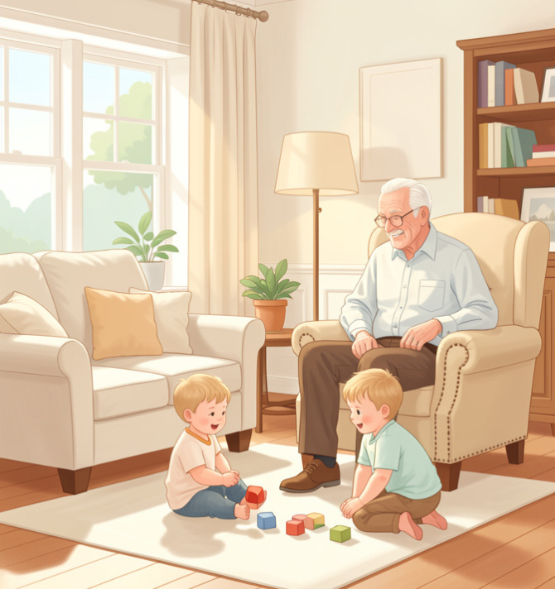
Listening: The Living Room
What do you hear?
Listen to the description: 'In this room, my grandfather is sitting in his favorite armchair reading the news. My younger brother is playing with blocks on the rug.'
Who is in this household?
Listen for keywords like 'Grandfather' or 'Sister'.
1
2
Identify the furniture mentioned.

Slide 7

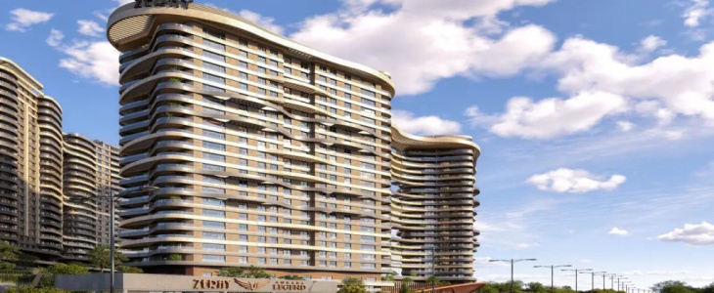
Where We Live: Different Houses
In Turkey, we live in various buildings depending on city or village life.
Detached Houses - Independent homes found in smaller towns or suburbs.
Apartment Flats - Common in cities. Many families share one tall building.

Slide 8
Match the Word
1.
Detached House
a)
Two parents and their children.
2.
Nuclear Family
b)
The group of people living in one home.
3.
Household
c)
Relatives like grandparents and aunts living together.
4.
Extended Family
d)
A standalone home not joined to others.

Slide 9
Match the Word
✅​
1.
Detached House
d)
A standalone home not joined to others.
2.
Nuclear Family
a)
Two parents and their children.
3.
Household
b)
The group of people living in one home.
4.
Extended Family
c)
Relatives like grandparents and aunts living together.

Slide 10


Comparing Homes
What are some advantages of living in a large extended family compared to a smaller nuclear family? Think about chores, fun, and space!

Slide 11
Comparing Homes
✅​
You might have said...
More people to help with household chores.
There is always someone to talk to or play with.
Grandparents can share wisdom and stories.
It might be noisier or have less personal space.

Slide 12
Final Check!
Answers on the next slide...
If Ayşe lives with her parents, her brother, and her grandmother, what kind of family structure does she have?
1.
Nuclear Family
2.
Extended Family
3.
Detached House
4.
Apartment Flat

Slide 13
Final Check!
✅​
If Ayşe lives with her parents, her brother, and her grandmother, what kind of family structure does she have?
1.
Nuclear Family
2.
Extended Family
👍​
3.
Detached House
4.
Apartment Flat

