Slide 1

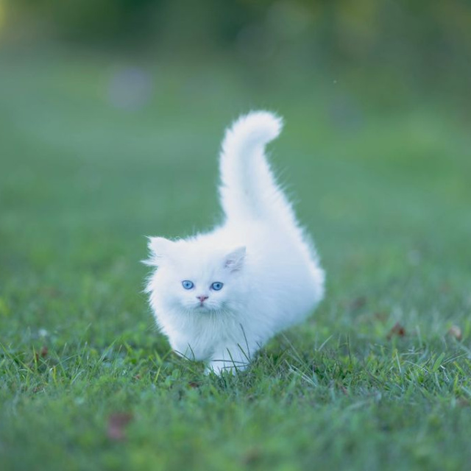
CARING FOR OUR ANIMAL FRIENDS
Learning how to use 'should' and 'shouldn't' to protect nature.

Slide 2

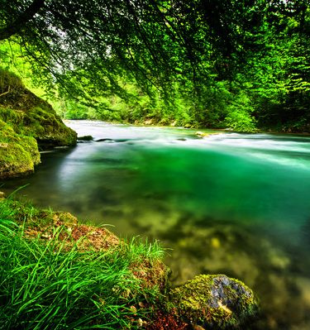
OUR GOALS TODAY
Today we will learn how to talk about our obligations to nature. By the end of this lesson, you will be able to:
Use should and shouldn't correctly.
Talk about how to protect the environment.
Understand how our behavior affects animals.

Slide 3
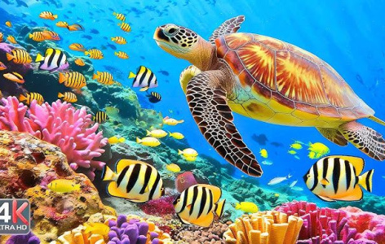
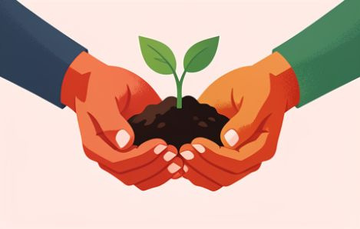
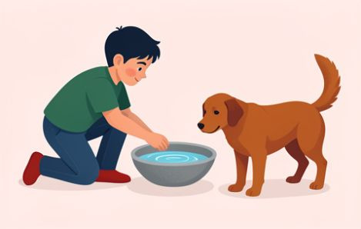
IMPORTANT WORDS TO KNOW
Environment
The natural world around us, like forests and oceans.
Protect & Protection
To keep something safe from harm or damage.
Behavior
The way a person or animal acts or conducts themselves.

Slide 4
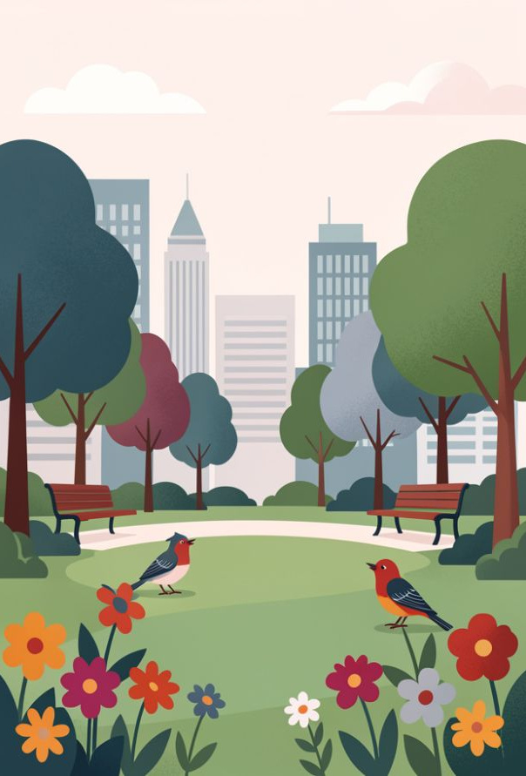
IMAGINE THIS...
What would you do?
You are walking in a beautiful park in Istanbul and see someone leaving their trash on the grass.
How does this make the park look? Does it help or hurt the animals living there?
🔑
Key point
Our small actions can have a big impact on the nature around us!

Slide 5
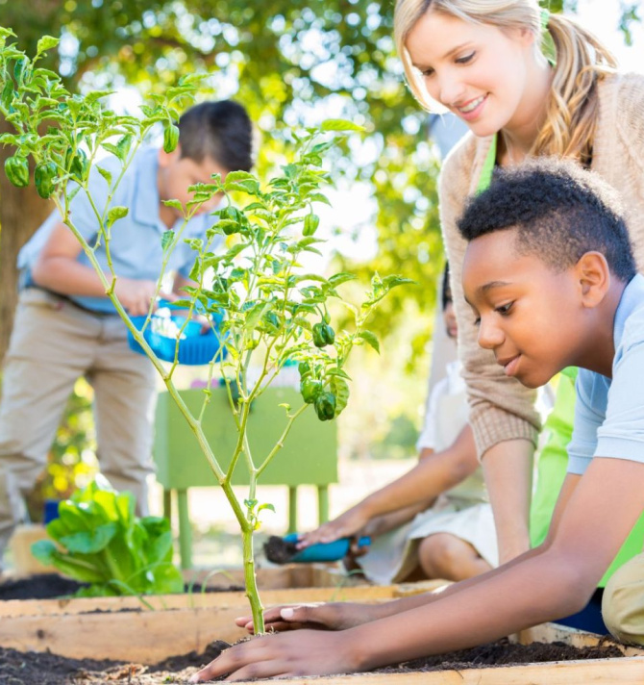
USING 'SHOULD' FOR GOOD HABITS
We use should to give advice or talk about things that are good to do.
We should keep the environment clean.
We should protect endangered animals.
We should plant more trees.
🔍
Example
You should always put your trash in the bin.

Slide 6
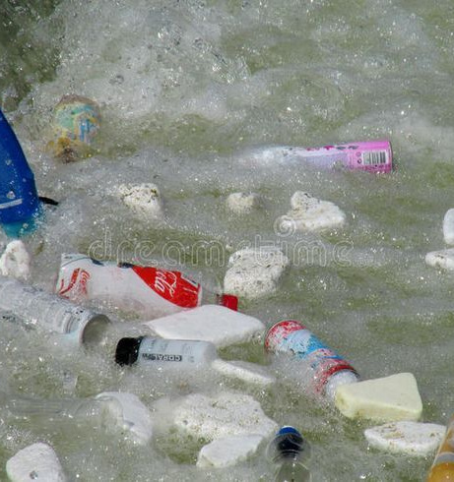
USING 'SHOULDN'T' TO PREVENT HARM
We use shouldn't (should not) when something is a bad idea or causes damage.
We shouldn't throw garbage in the sea.
We shouldn't harm animal habitats.
We shouldn't waste water.
⚠️
Watch out
Animals can get sick if they eat the trash we leave behind.

Slide 7
A TALK ABOUT STREET ANIMALS
Listen to the audio and decide: true or false?
1
👍​ | 👎​ Mert and Elif want to help a hungry cat.
2
👍​ | 👎​ Elif says Mert should give the cat his sandwich.
3
👍​ | 👎​ They think they should find a box for the cat.
4
👍​ | 👎​ They are going to the market to buy a toy.
Answers on the next slide...

Slide 8
A TALK ABOUT STREET ANIMALS
✅​
Check your answers below
1
👍​ They both agree the cat looks hungry and they want to provide food.
2
👎​ Elif says he shouldn't because human food can make cats sick.
3
👍​ They want to find a box so the cat doesn't have to stay in the rain.
4
👎​ They are going to the market specifically to buy cat food.

Slide 9
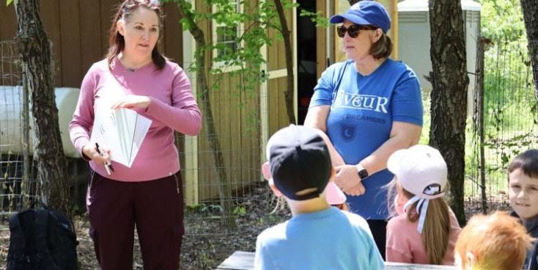
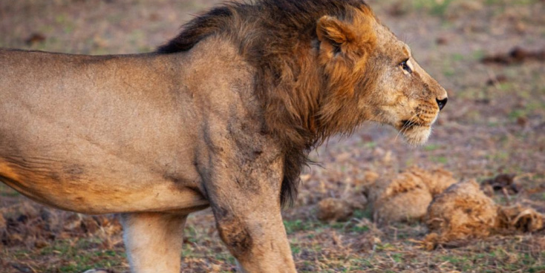
PROTECTING WILD ANIMALS
Do's
We should donate to charities.
We should visit national parks carefully.
We should learn about nature.
Don'ts
We shouldn't cut down forests.
We shouldn't hunt wild animals.
We shouldn't keep wild animals as pets.

Slide 10
MATCH THE WORDS
1.
Protect
a)
Something you must do because it is right.
2.
Damage
b)
The natural world around us.
3.
Obligation
c)
To keep something safe.
4.
Environment
d)
Harm caused to something.

Slide 11
MATCH THE WORDS
✅​
1.
Protect
c)
To keep something safe.
2.
Damage
d)
Harm caused to something.
3.
Obligation
a)
Something you must do because it is right.
4.
Environment
b)
The natural world around us.

Slide 12
FINAL CHECK!
Answers on the next slide...
Which sentence is the best advice for visiting a forest?
1.
We should leave our plastic bags on the grass.
2.
We shouldn't disturb the animals' nests.
3.
We should cut down trees for firewood.
4.
We shouldn't worry about keeping the water clean.

Slide 13
FINAL CHECK!
✅​
Which sentence is the best advice for visiting a forest?
1.
We should leave our plastic bags on the grass.
2.
We shouldn't disturb the animals' nests.
👍​
3.
We should cut down trees for firewood.
4.
We shouldn't worry about keeping the water clean.

